Slide 1
Visa World Solutions
Back to Éducation

Slide 2
www.visaworldsolutions.com

Slide 3
Visa World Solutions' CEO is a founder partner of London St. Andrew’s College –and Marketing Manager, student welfare office of the college.

Slide 5
Visa world solutions a member if WEBA agent and attend a seminar at Sheraton hotel Heathrow – London -

Slide 6
Visa World Solutions –London office

Slide 7
Title

Slide 8
Visa World Solutions Colleagues

Slide 9
London Office

Slide 10
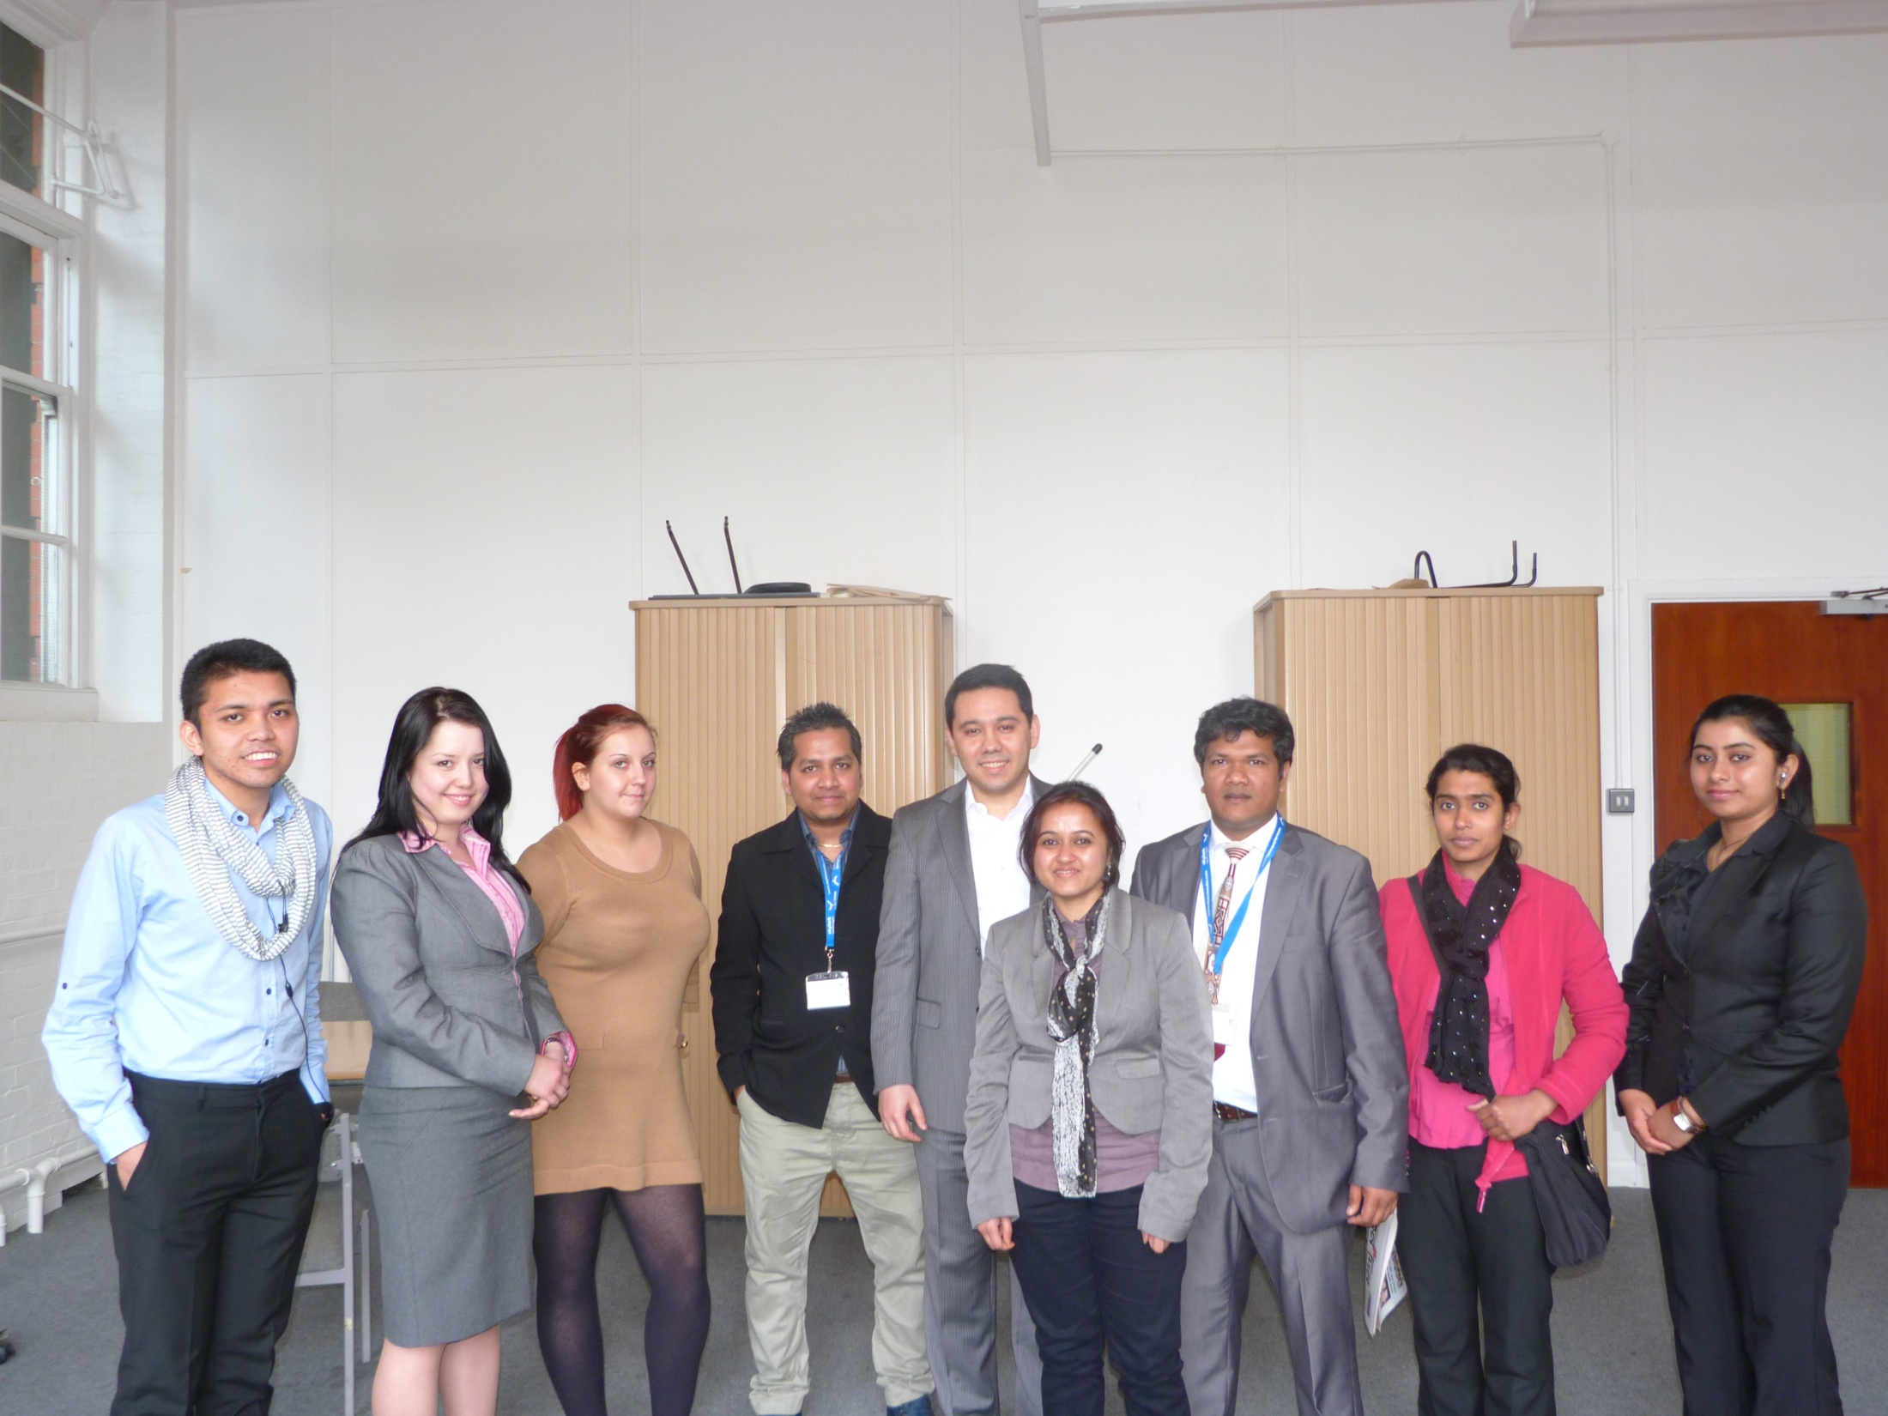
LSBF AND VISA WORLD SOLUTIONS

Slide 11
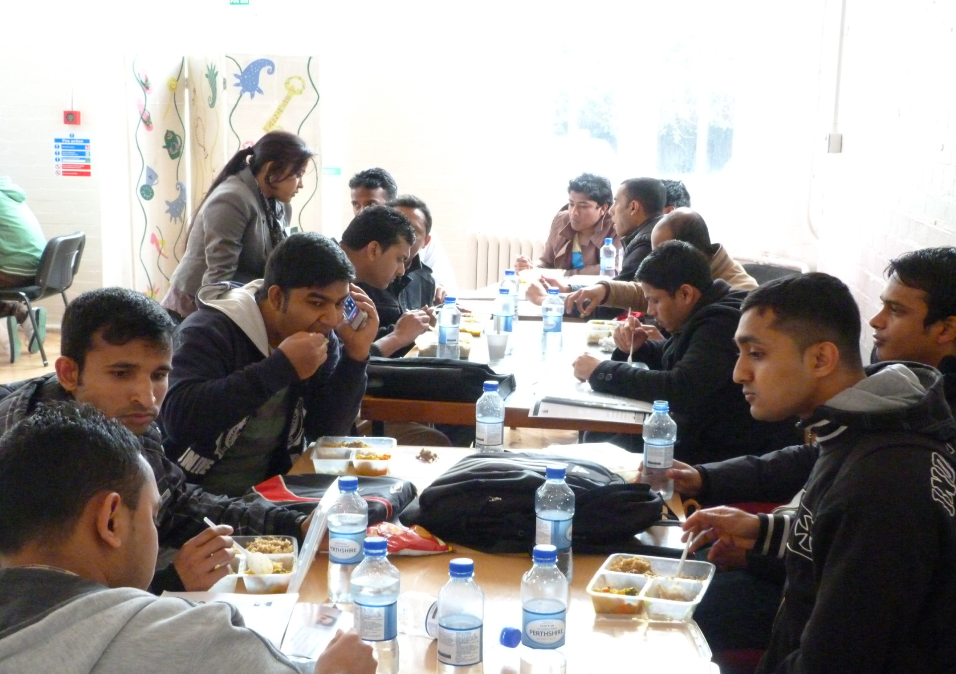
Visa world solutions organised student lunch party

Slide 12
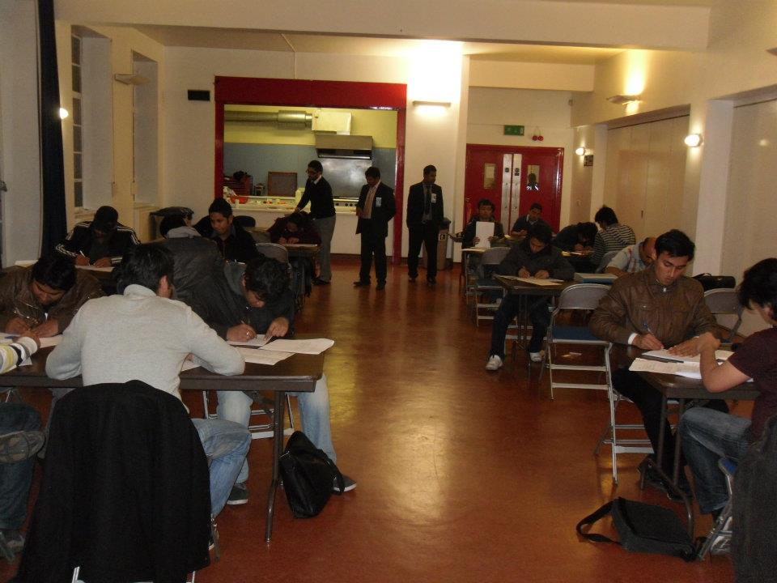
University of Ulster taking –English test exam, visa world solutions organised

Slide 13
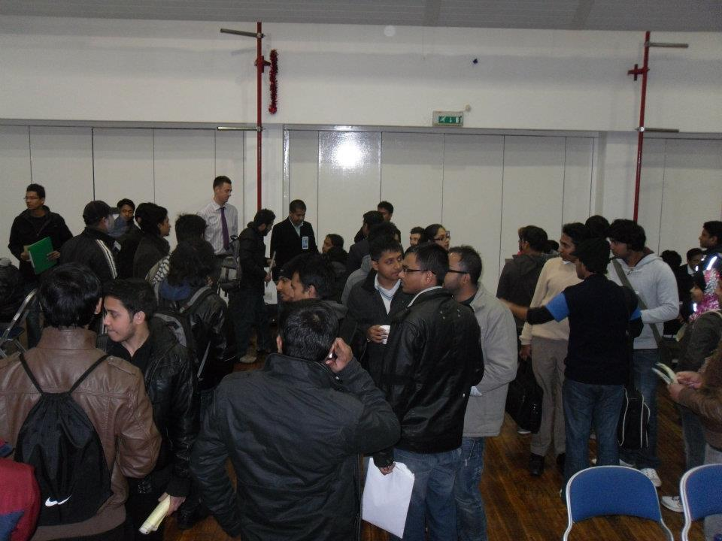
Spot admission organised by visa world solutions – in london

Slide 14
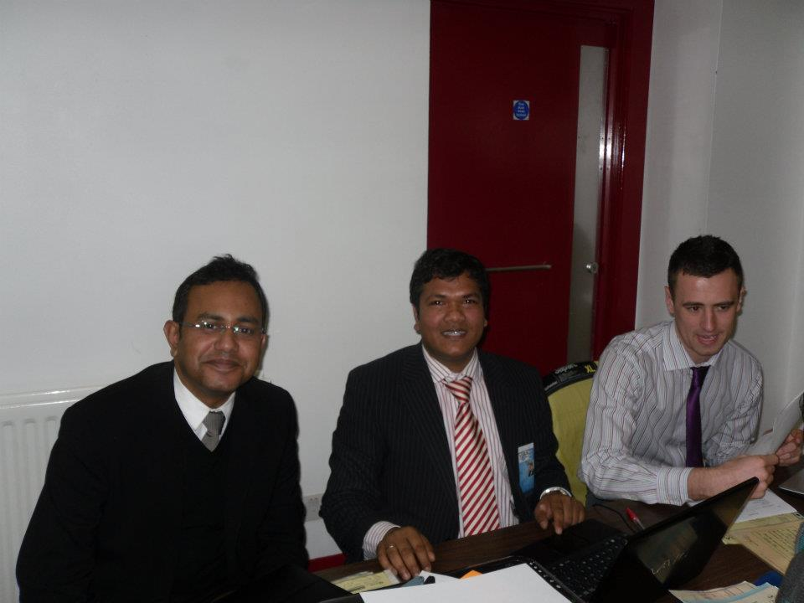
Mr. Arefin, Mr. Jack and myself doing file assesment

Slide 15
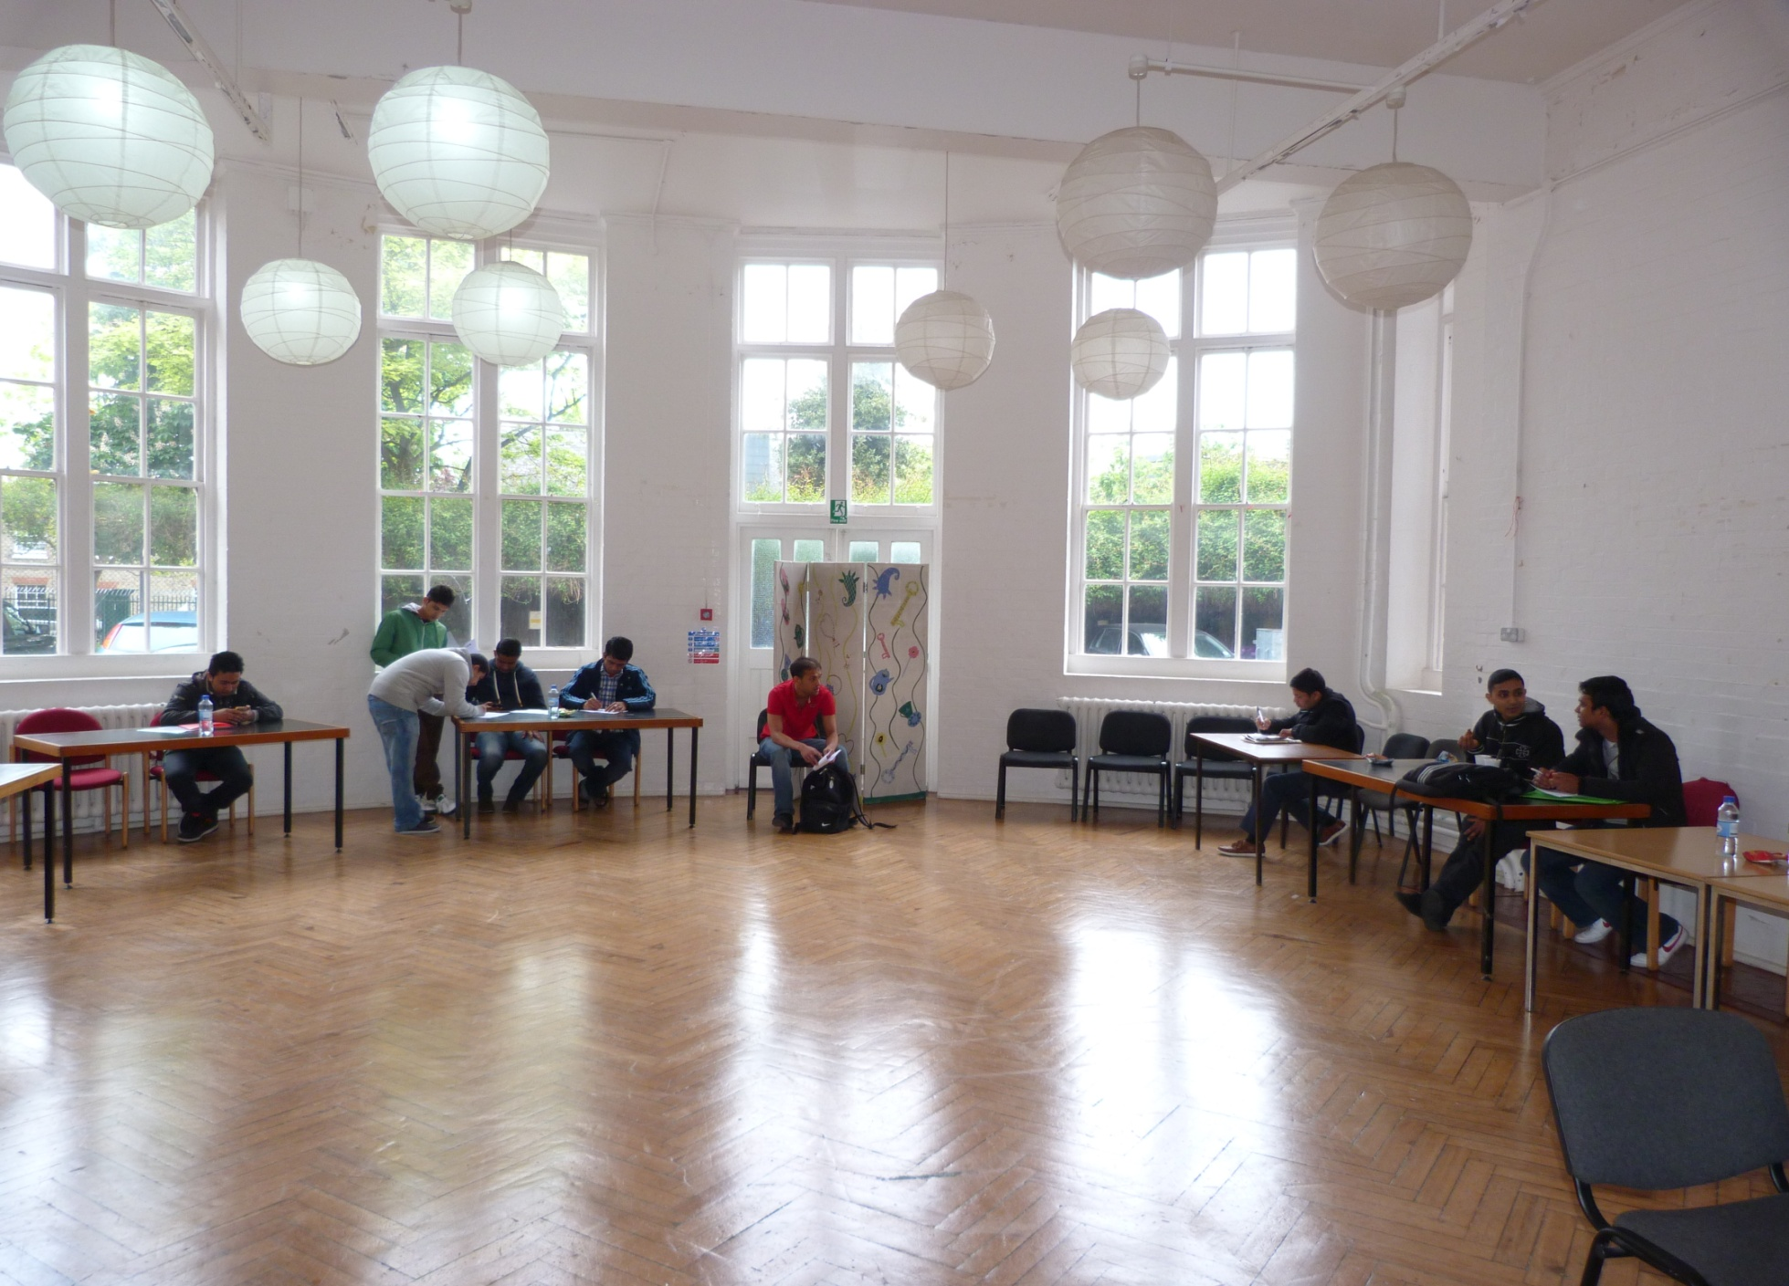
Visa world solutions organised student evening for music and entertainment

Slide 16
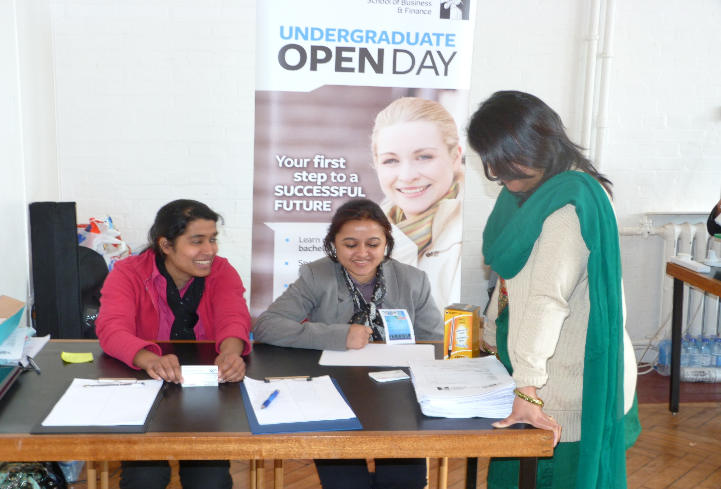
Our colleagues on open day

Slide 17
Visa World Solutions Attend Bengali new years celebration in london

Slide 18
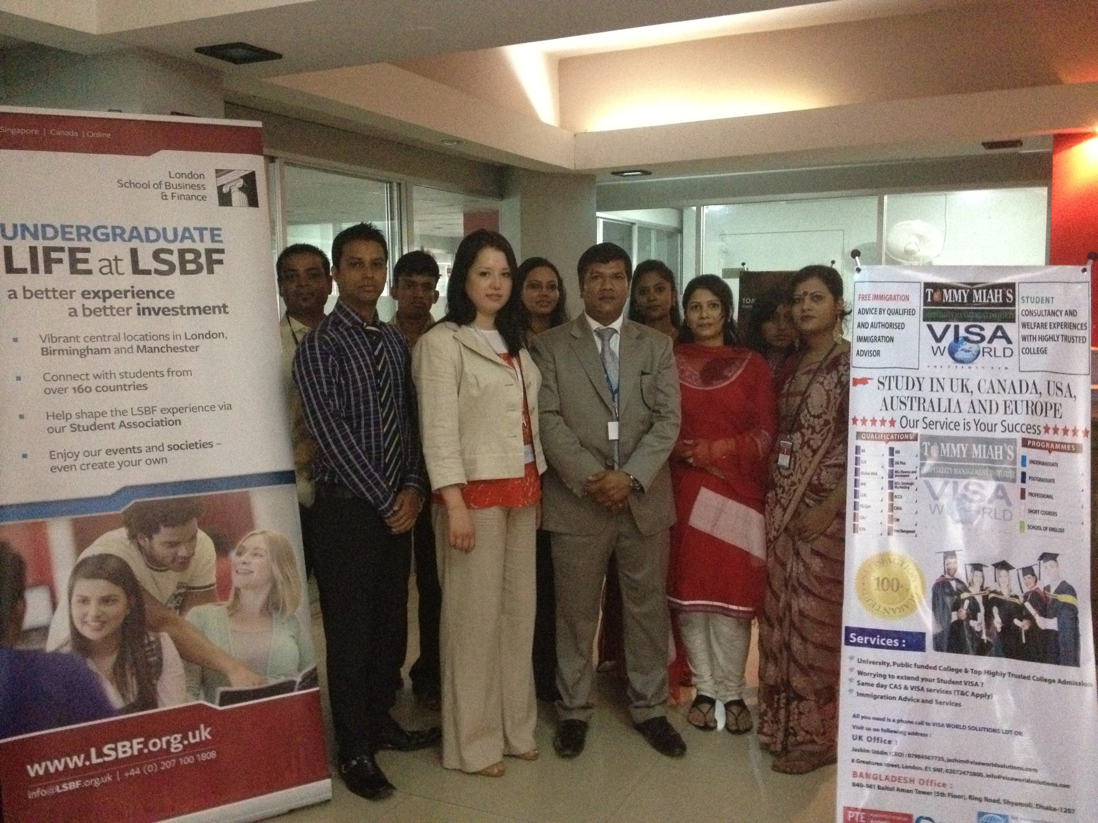
Visa World Solutions and Tommy miah Organised spot admission in Dhaka Bangladesh

Slide 19
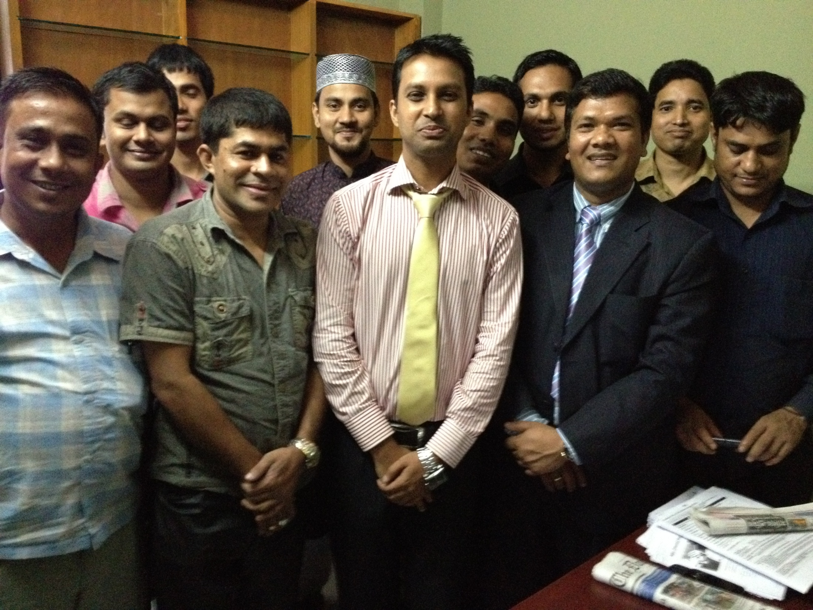
Visa World Solutions Sub Agents- Bangladesh

Slide 20
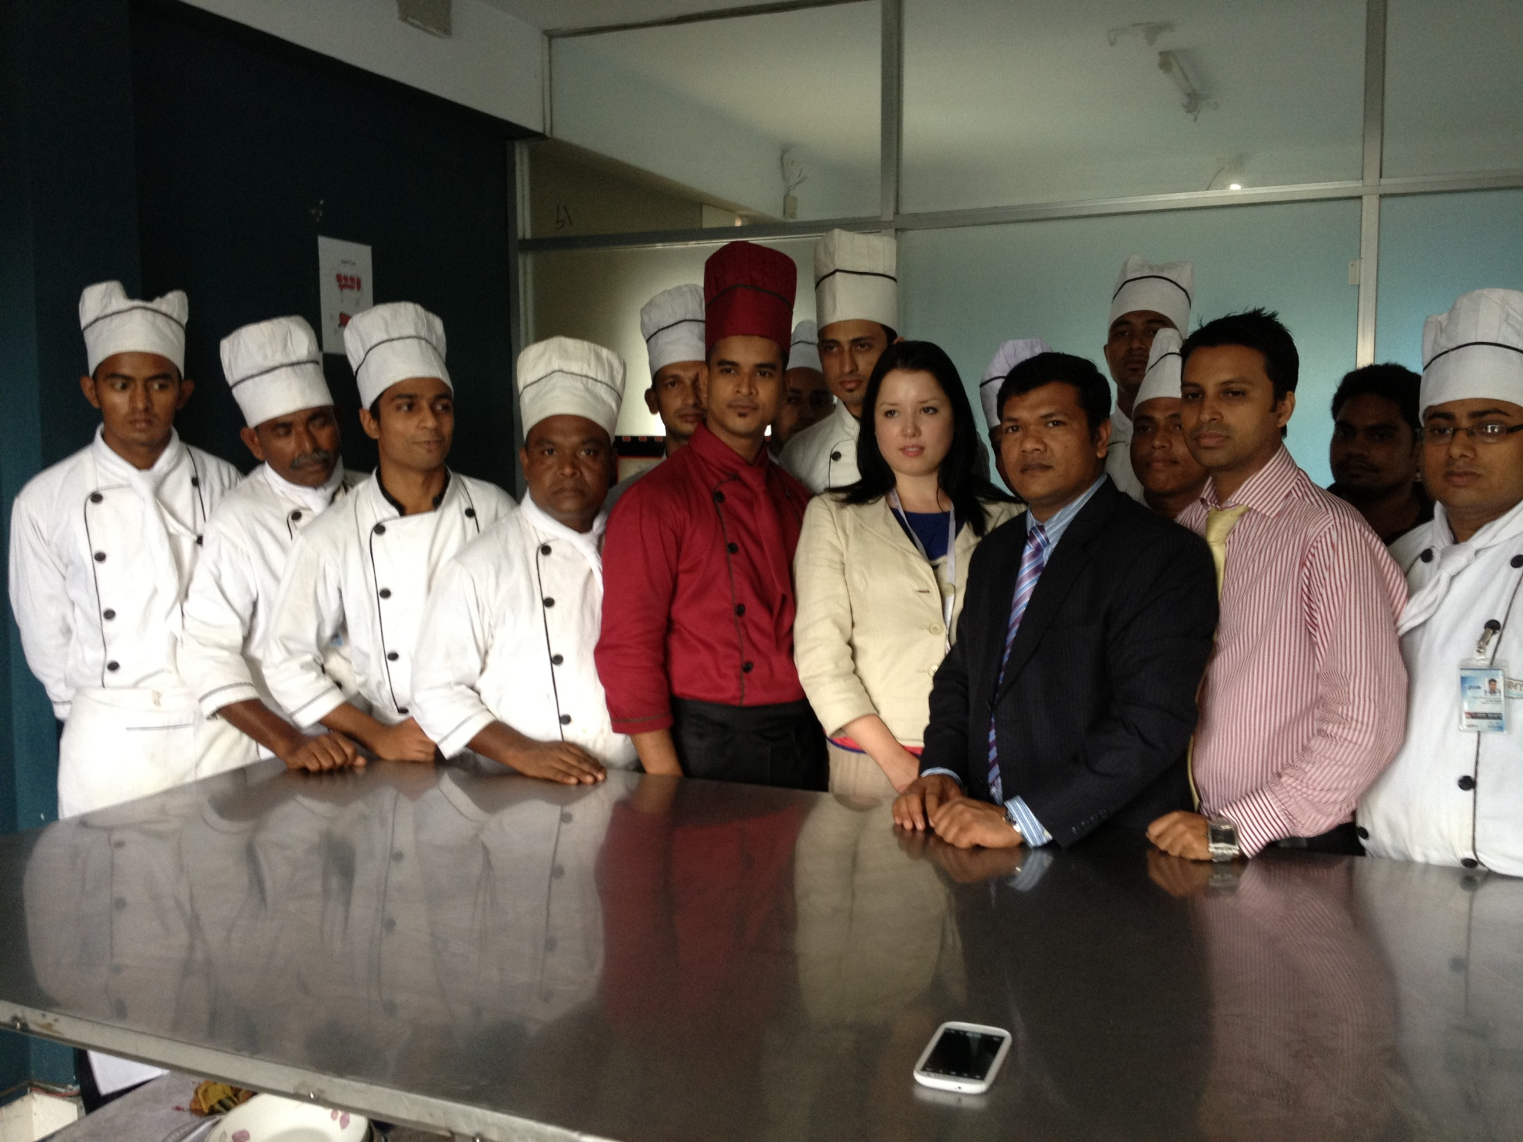
Visa World Solutions and Tommy miah Organised spot admission in sylhet-Bangladesh

Slide 21
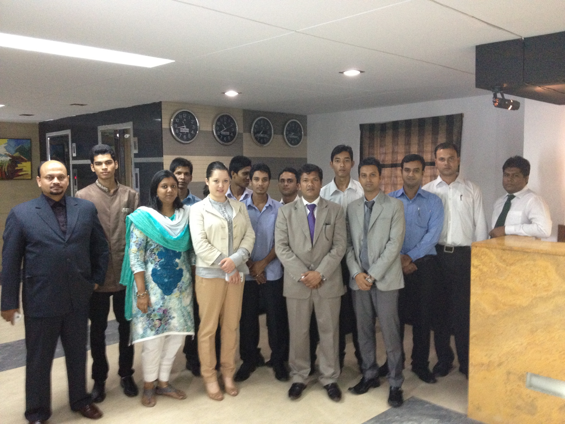
Visa World Solutions and Tommy miah Organised spot admission in sylhet-Bangladesh

Slide 22
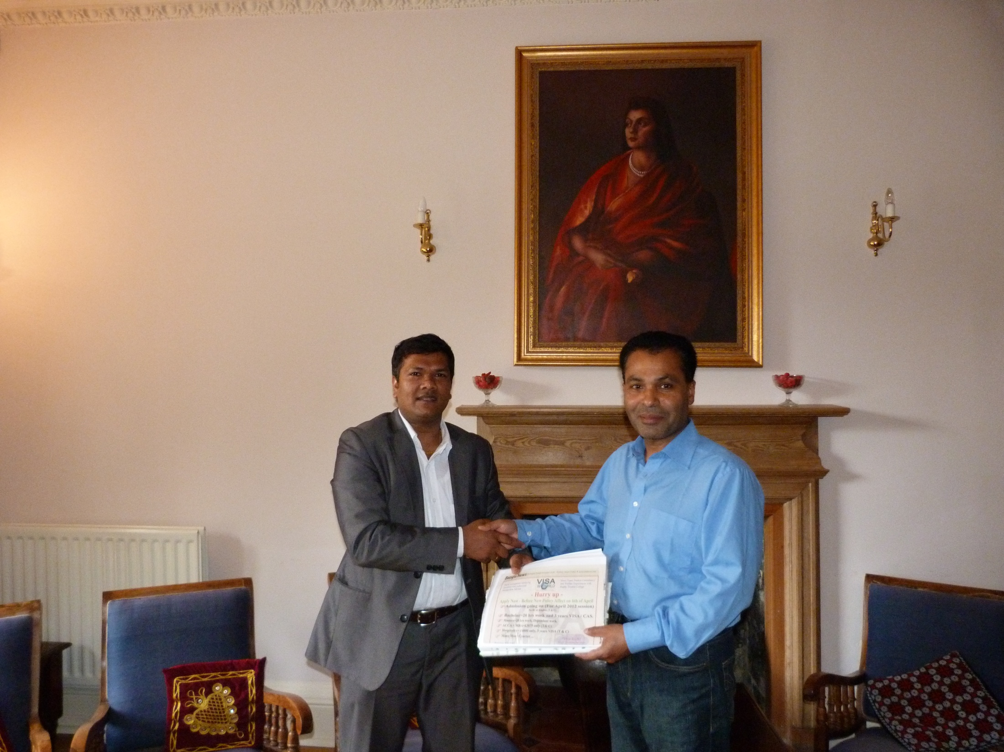
Visa World Solutions and Tommy miah signed a agreement to work together for recruiting Bangladeshi students

Slide 23
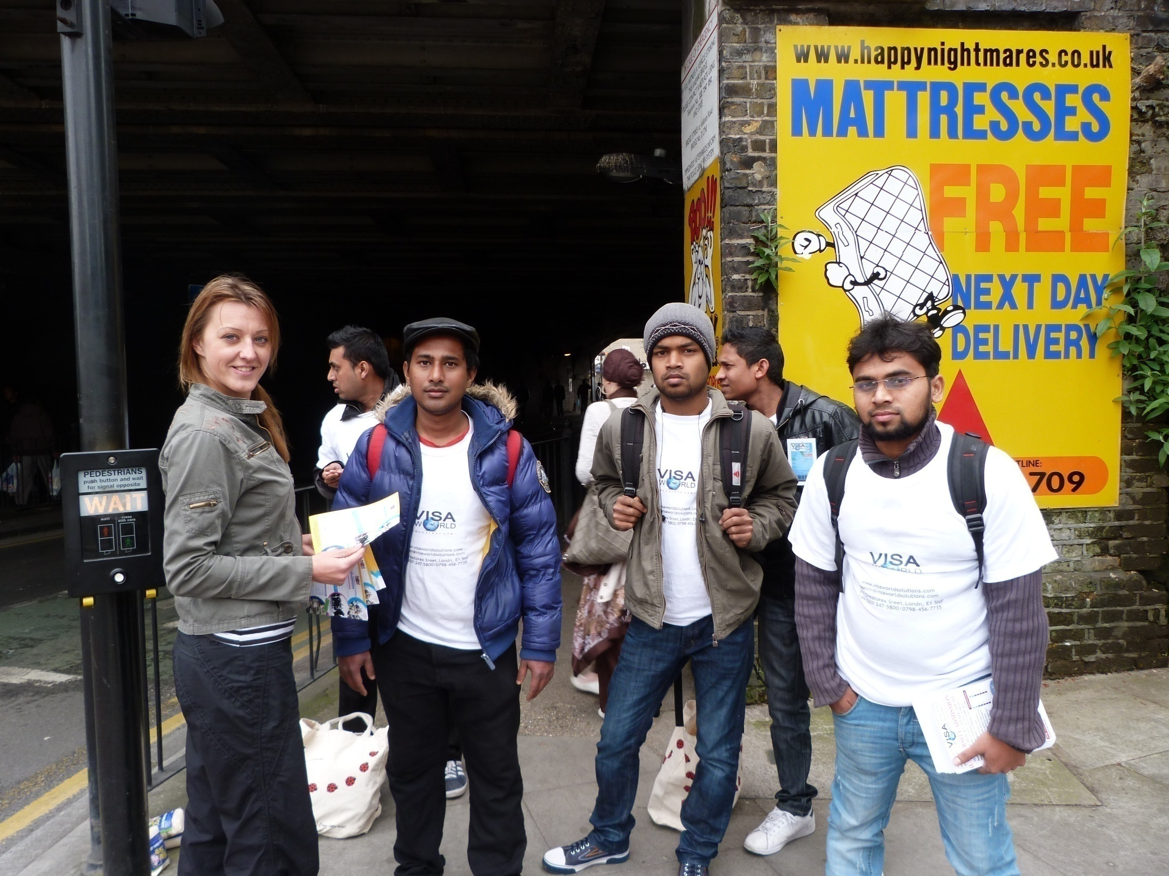
Our marketing team doing leafleting

Slide 24
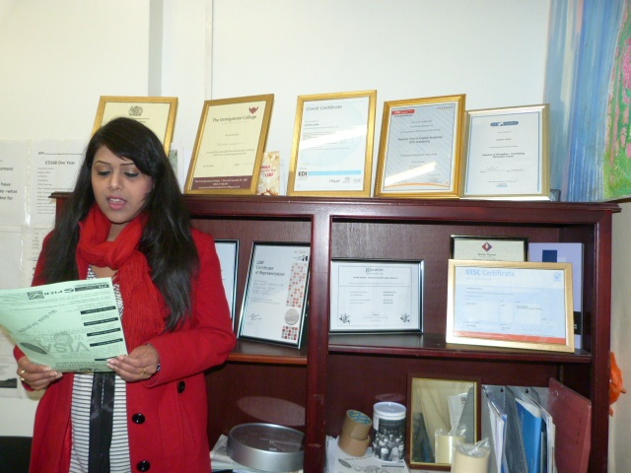
Bangladeshi Famous Singer visited Visa World Solutions and recommends students

Slide 25
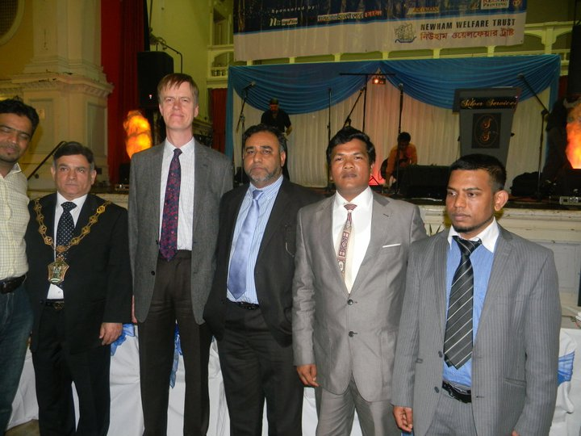
MP,MAYOR ,COUNCILOR AND COMUNITY LEADERS WITH VISA WORLD SOLUTIONS CEO JASHIM UDDIN

Slide 26
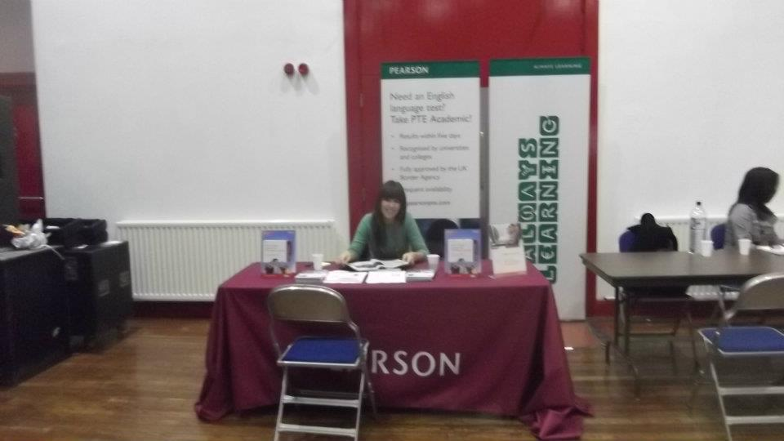
PEARSON VISITED TO VISA WORLD SOLUTIONS

Slide 27
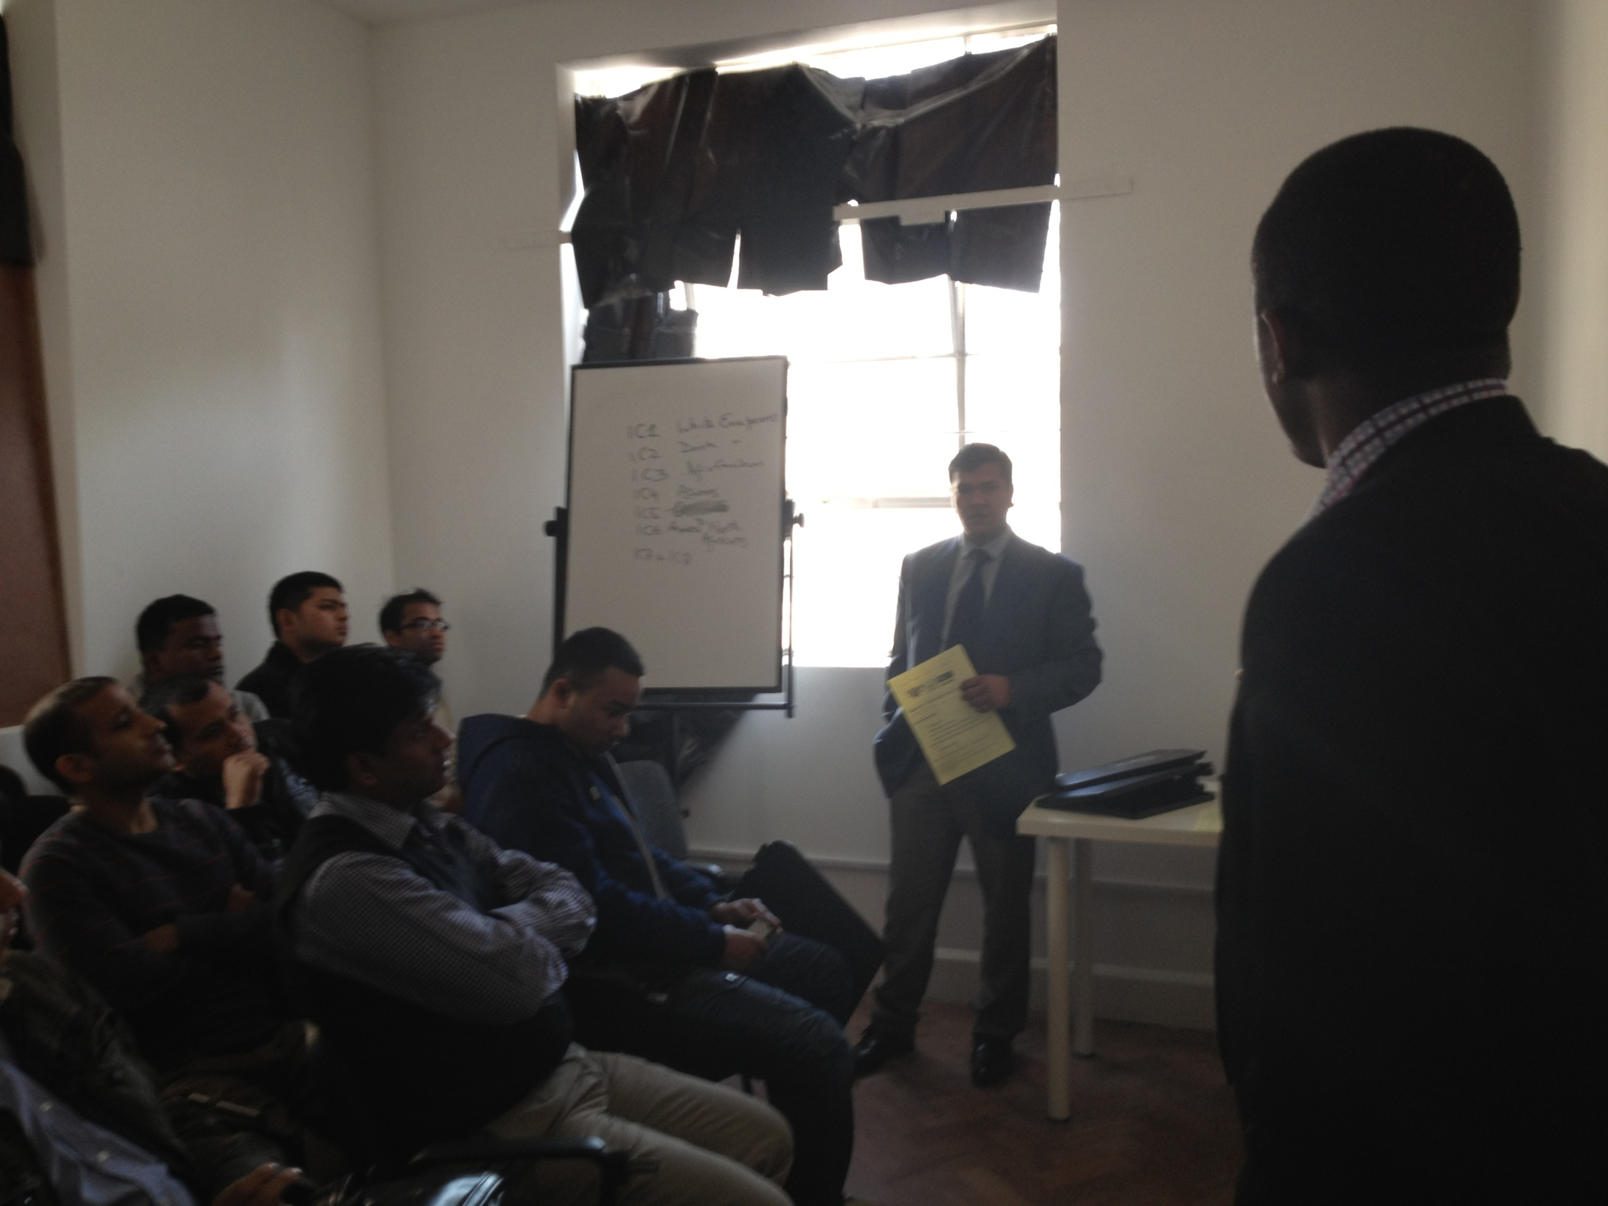
Agent training and presentation during randomly college suspended by UKBA

Slide 28
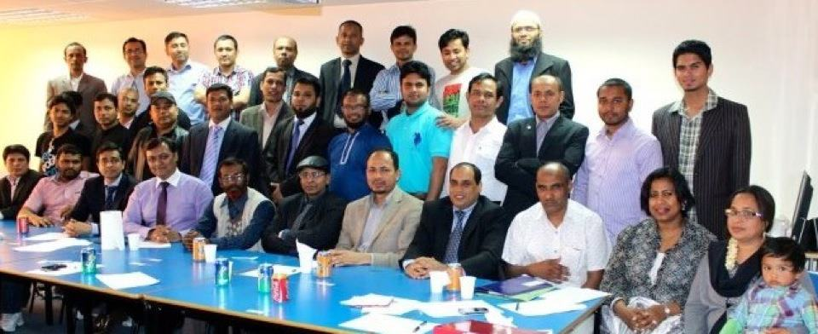
Community and volunteer work

Slide 29
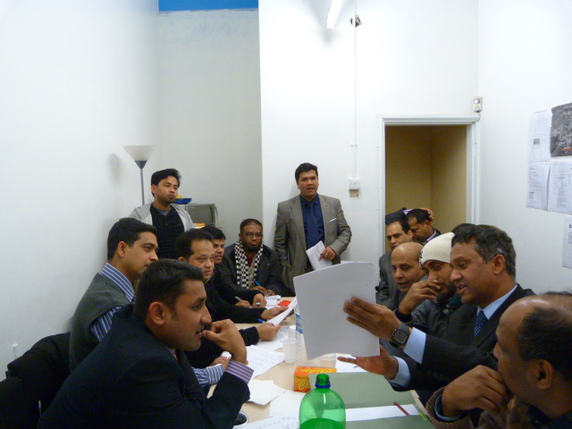
Community meeting into visa world solutions’s office and jashim uddin hosting

Slide 30
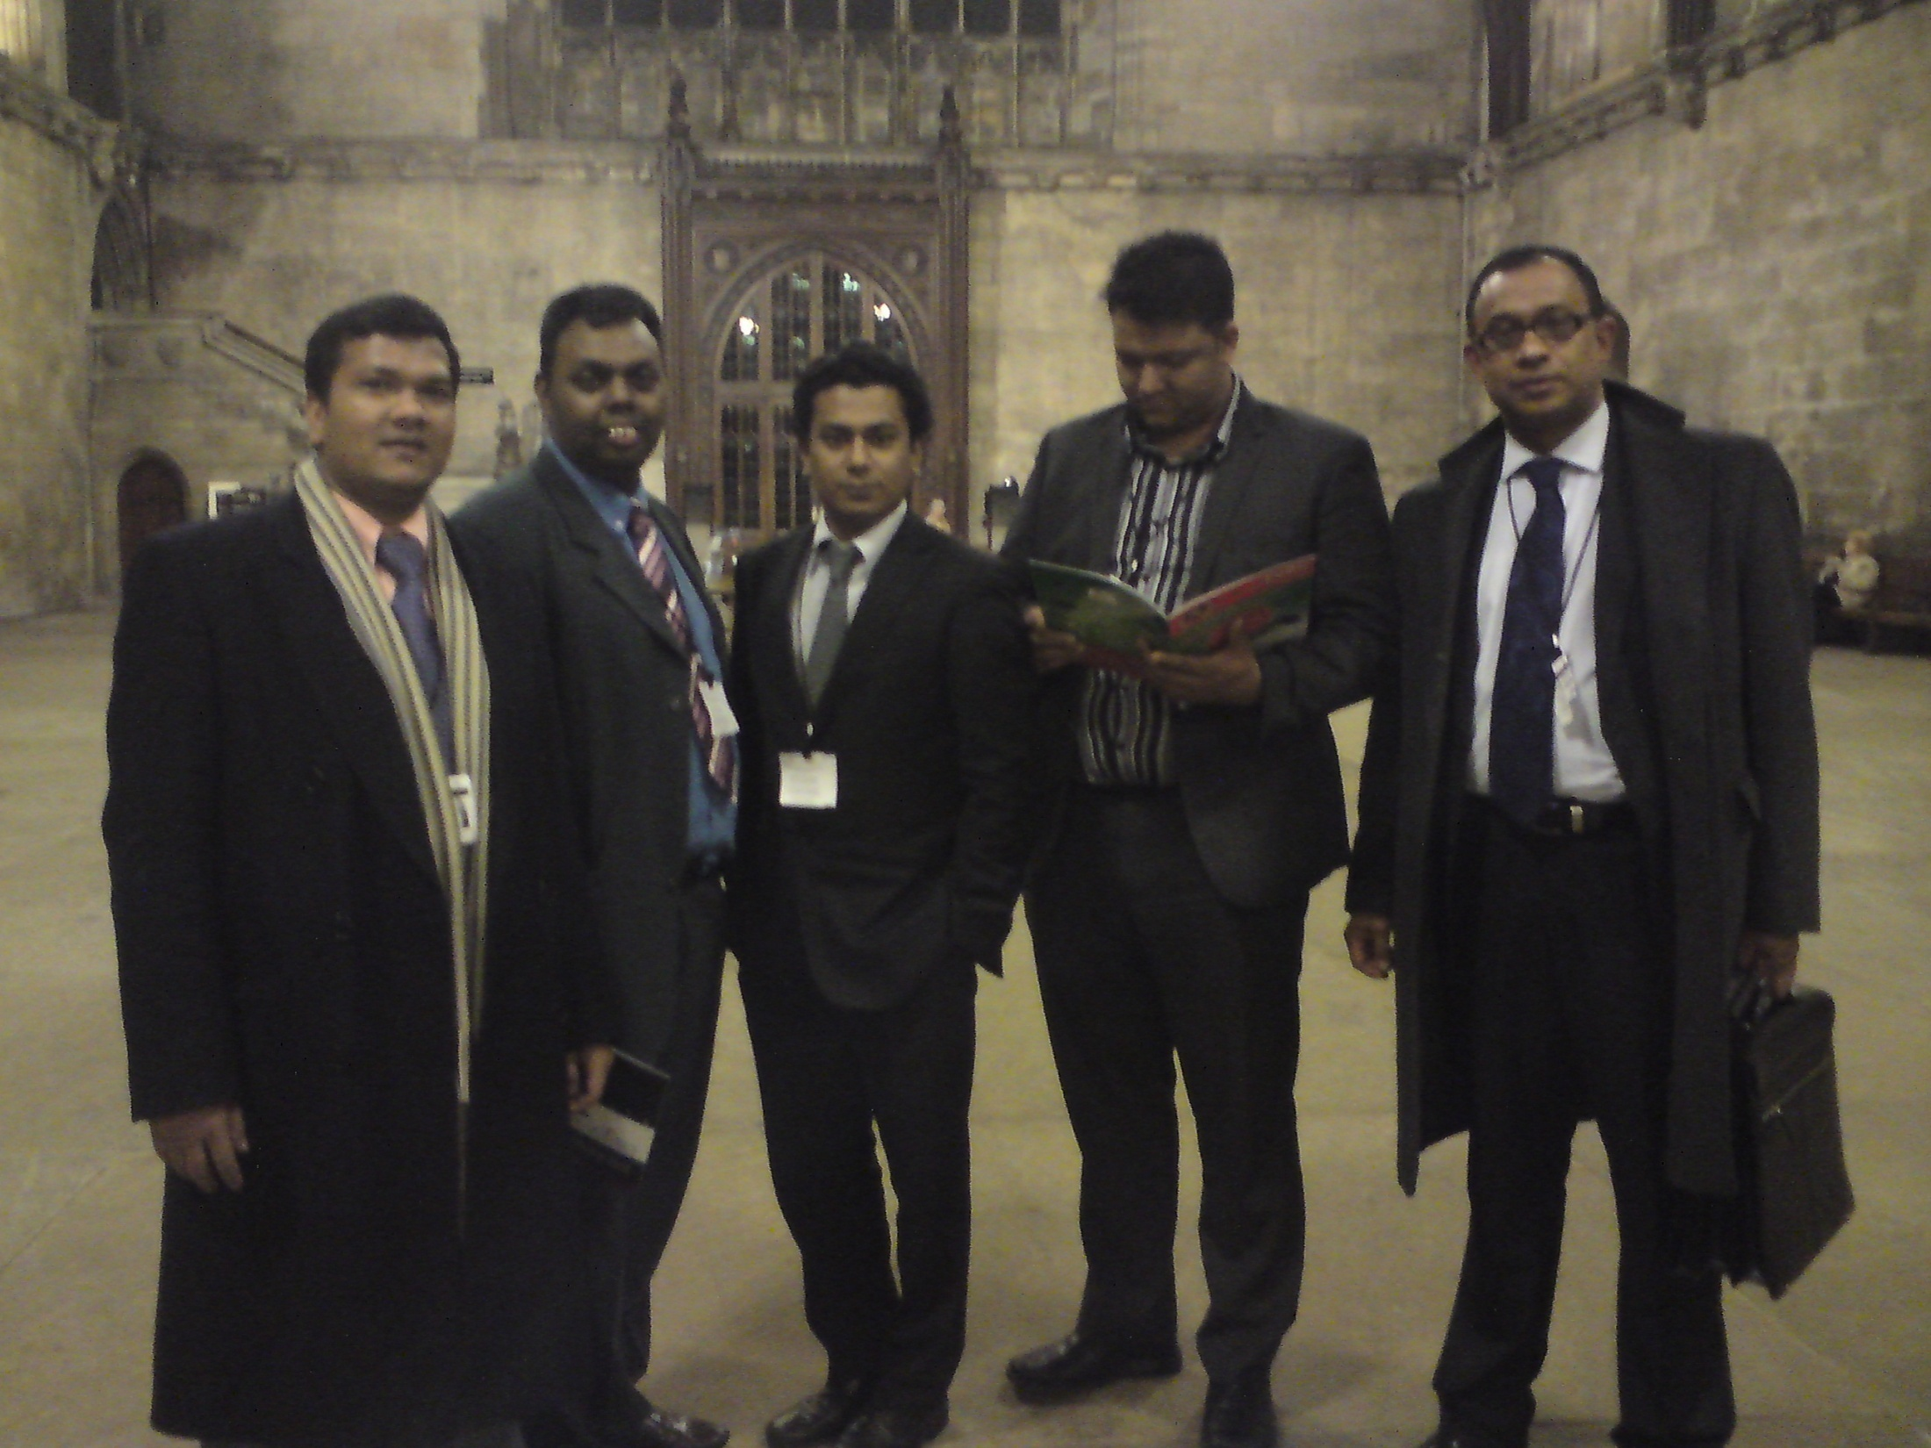
Community meeting in British parliament

Slide 31
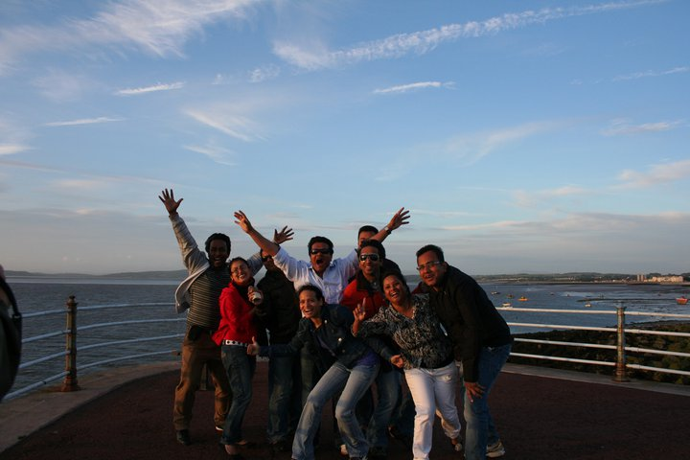
Celebrate after successfully enrolled many students

Slide 32
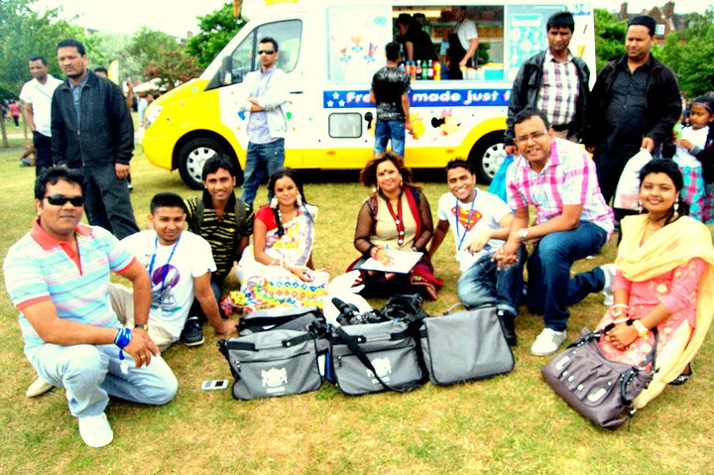
Social activities with students

Slide 33
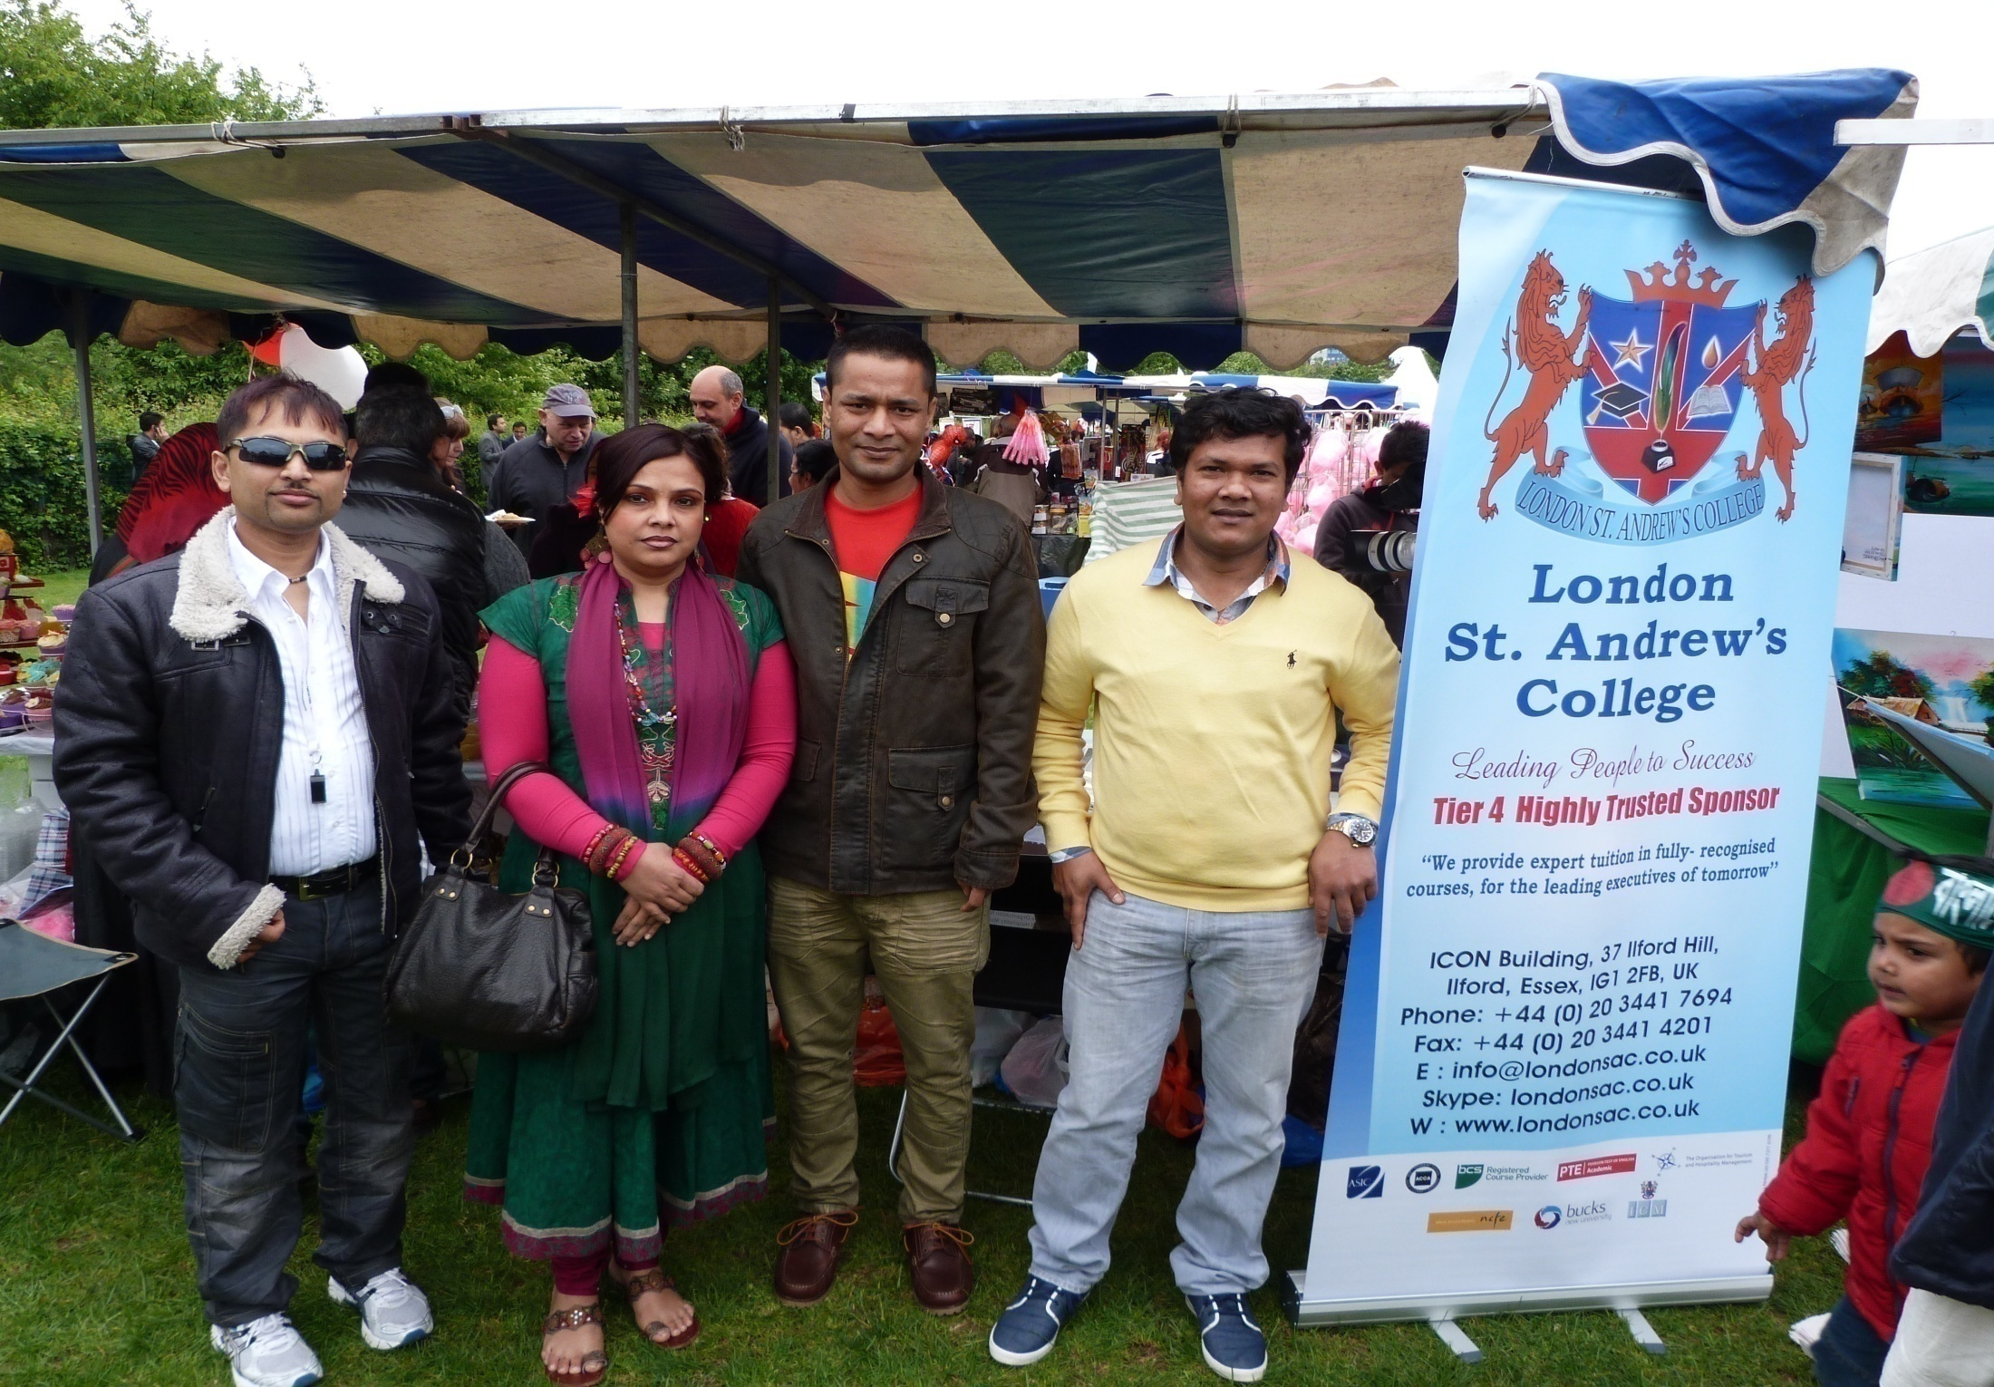
Social activities with students

Slide 34
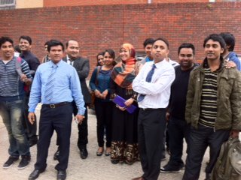
Meeting with group of students and teachers

Slide 36
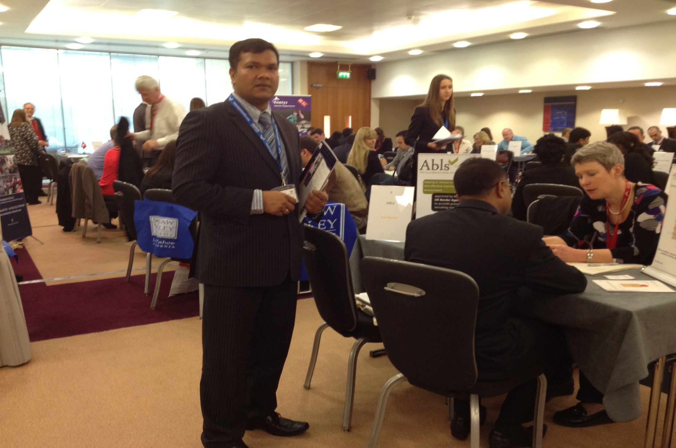
Sheraton Heathrow education seminar

Slide 37
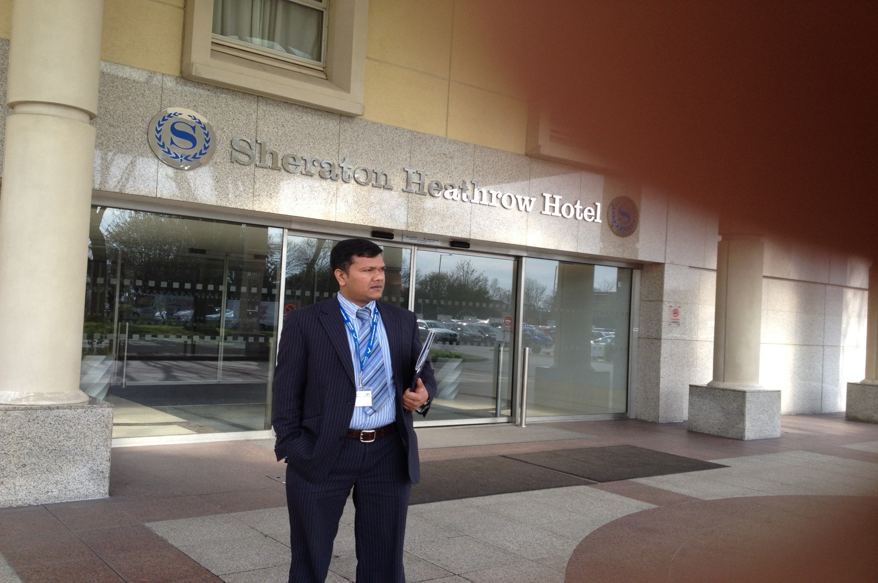
Sheraton Heathrow education seminar

Slide 38
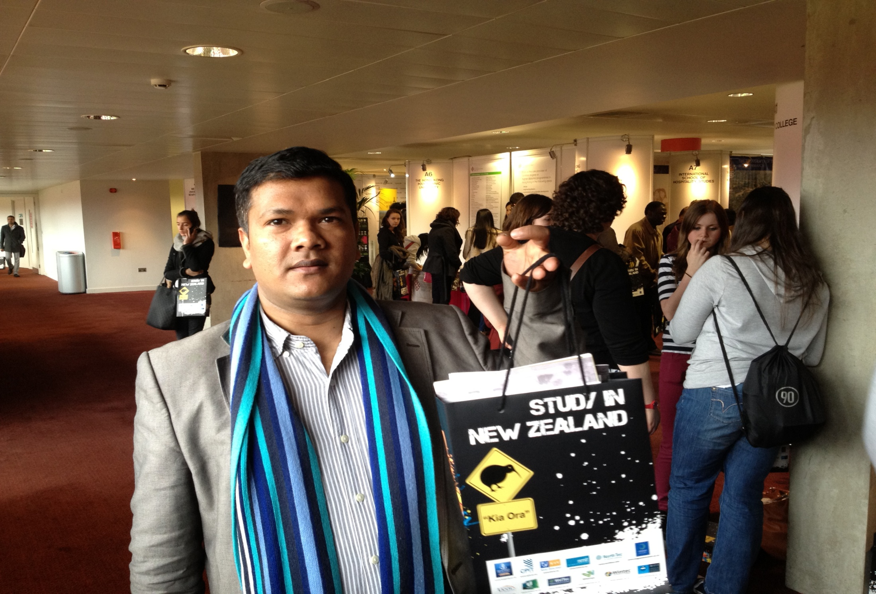
Arsenal Stadium international agent fair –London

Slide 39
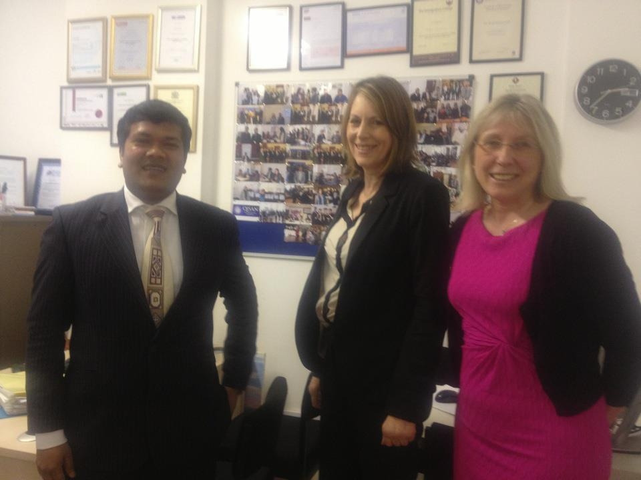
Peterborough College visit visa world solutions

Slide 40
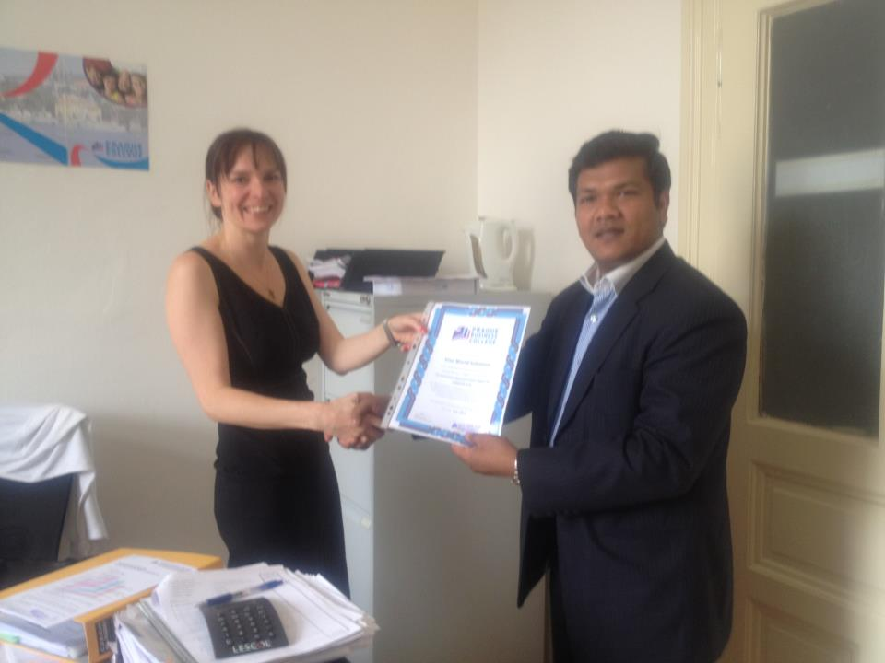
Prague Business College – Prague city

Slide 41
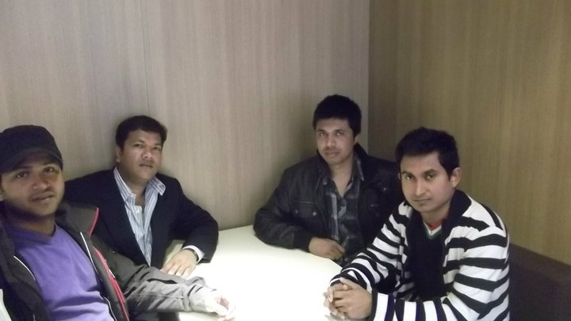
Meeting with Denmark Bangladeshi Student Association at Copenhagen.

Slide 42
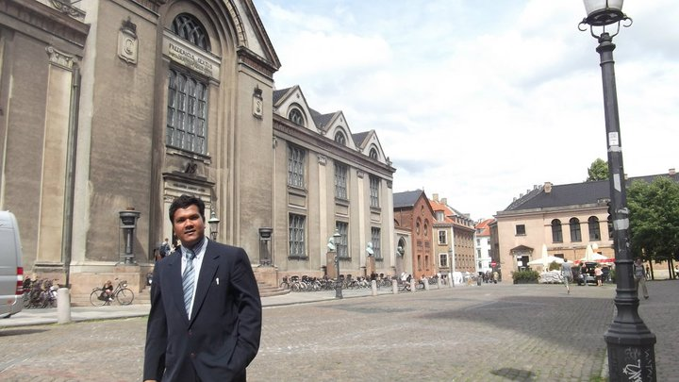
Copenhagen university –Denmark

Slide 43
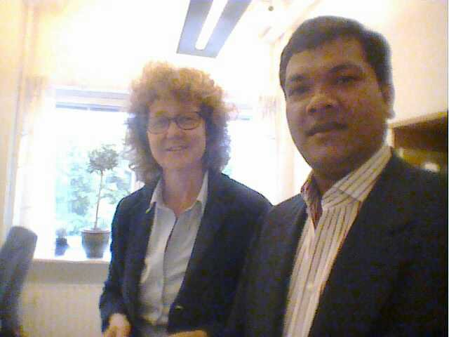
Stockholm University - Sweden

Slide 44
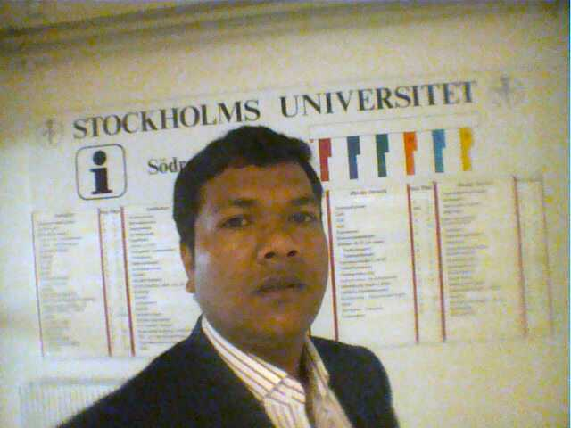
Stockholm University - Sweden

Slide 45
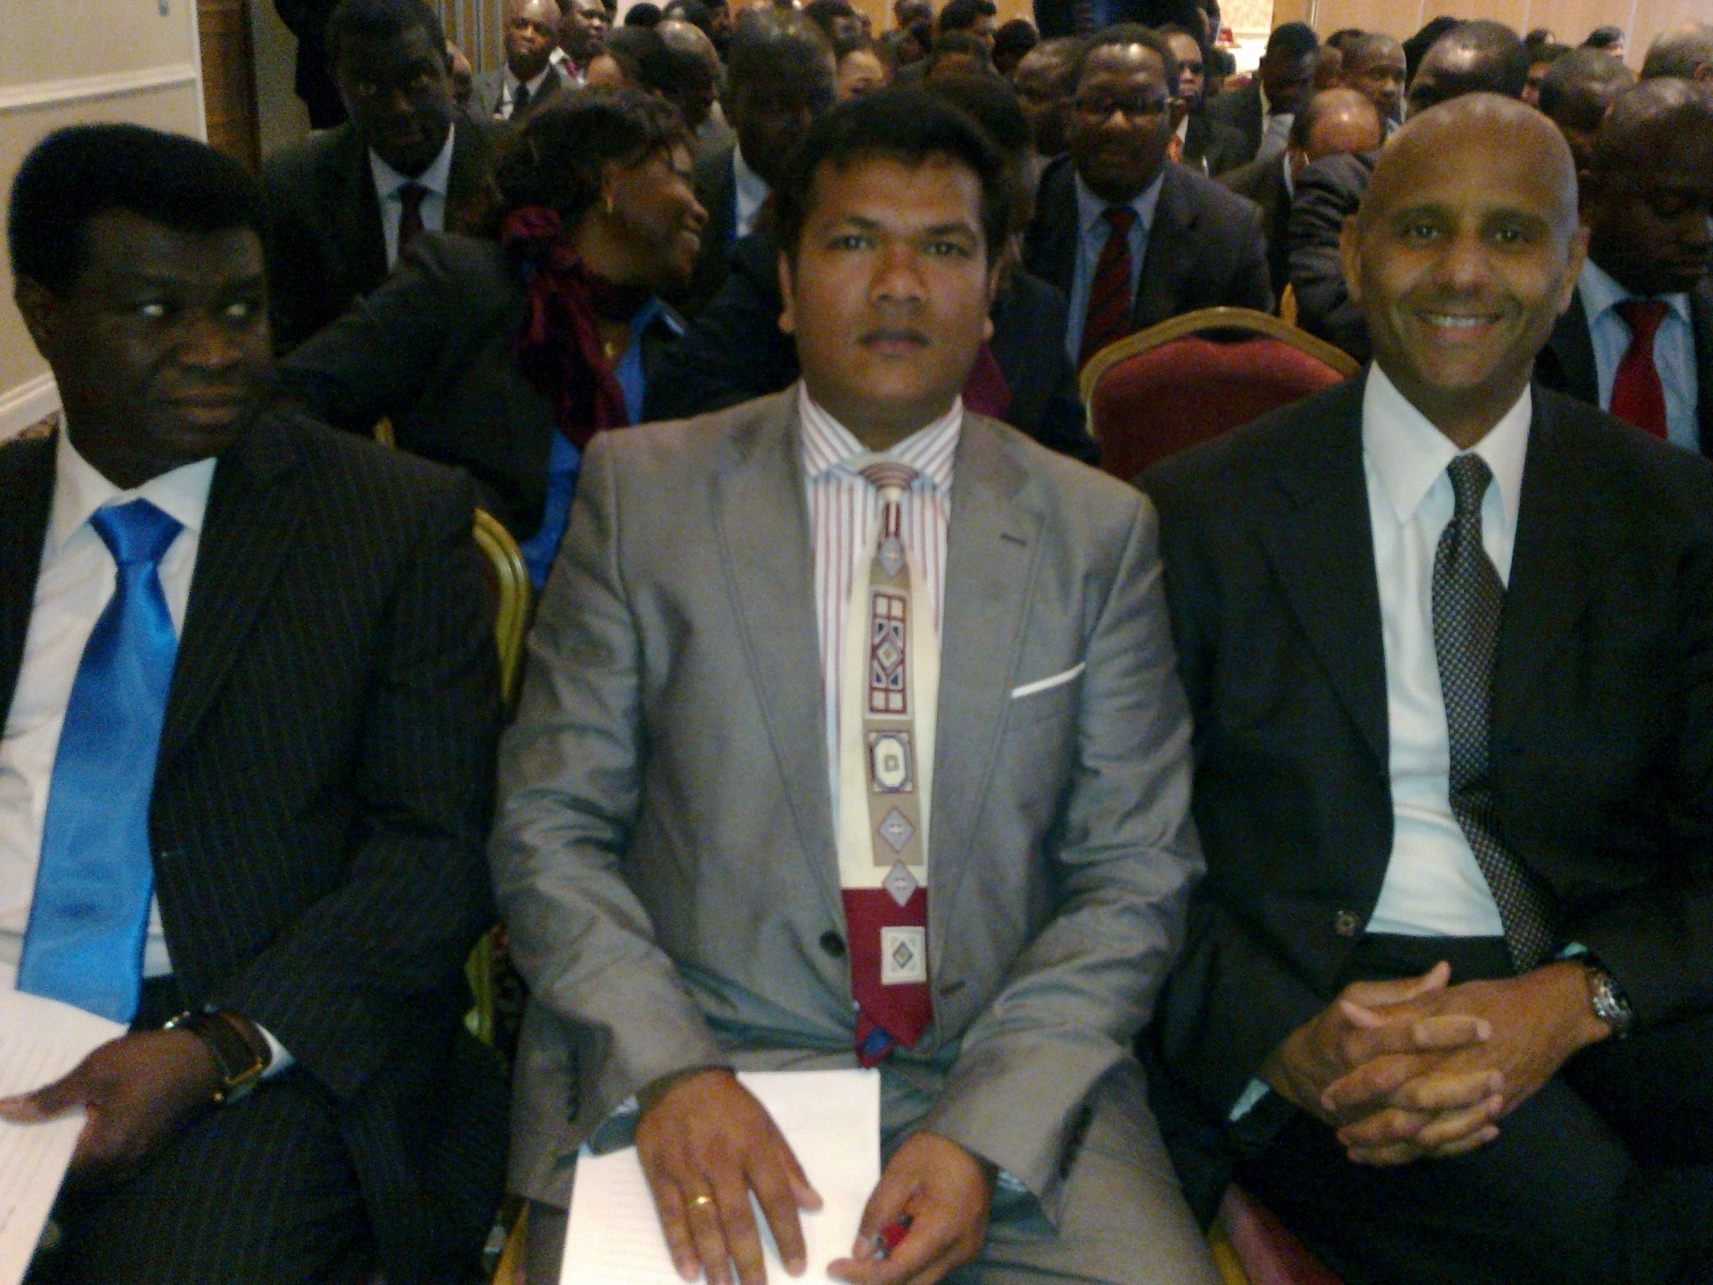
African education seminar

Slide 46
Hospitality Practical Training from celebrity chef – London

Slide 47
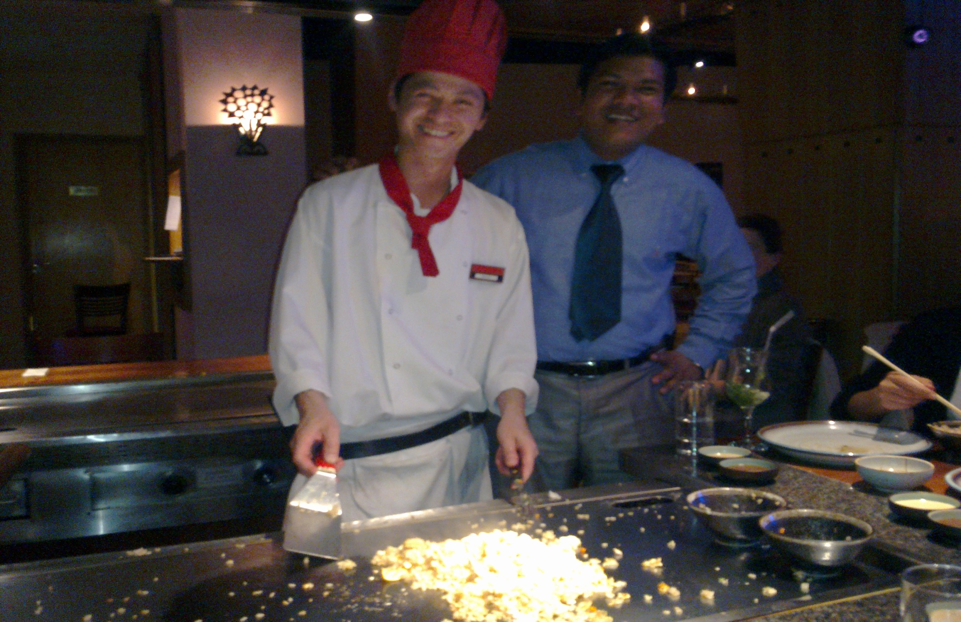
Hospitality Practical Training from celebrity chef – London

Slide 48
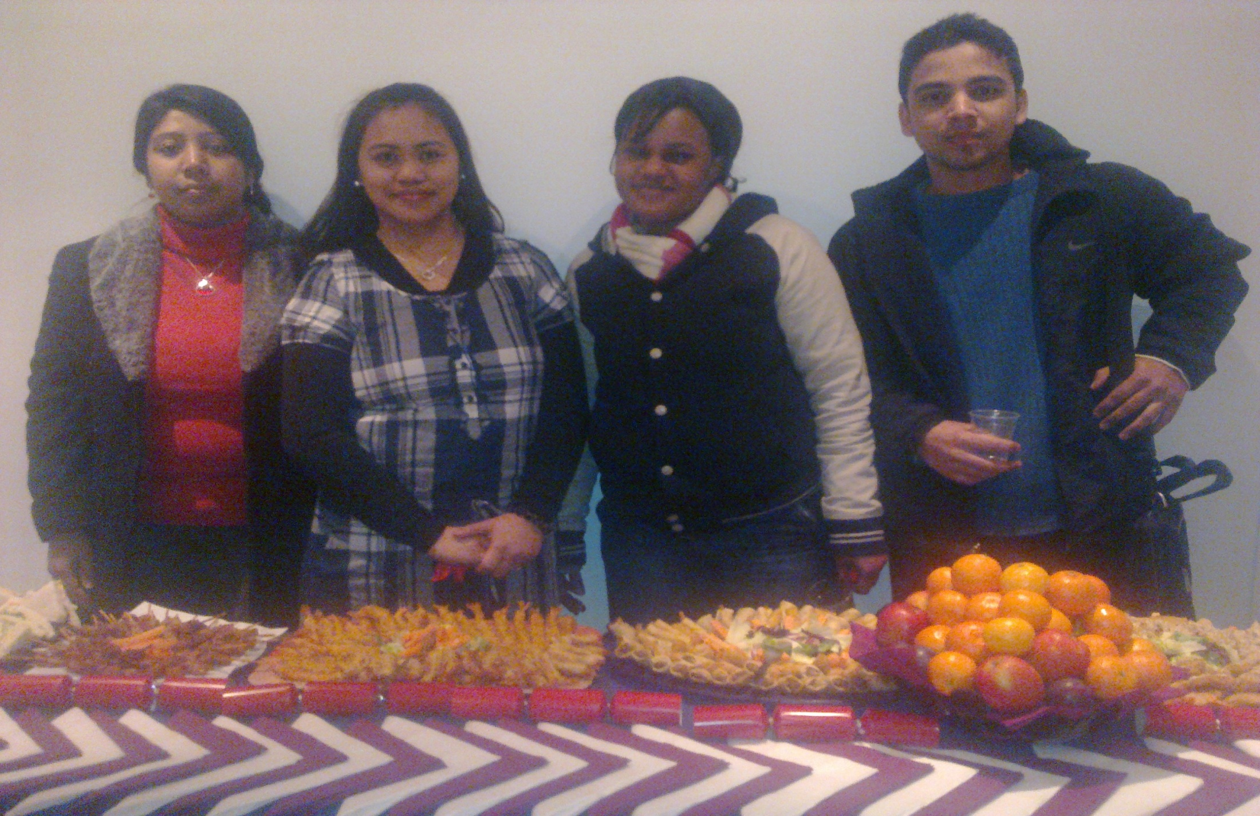
Hospitality Practical Training from celebrity chef – London

